Slide 1
Exploring the galaxy
Building emulators to find vulnerabilities
in modern phones
Alexander Tarasikov

Slide 2
About me (@astarasikov)
In previous life
Porting Linux to smartphones
Operating Systems development
Virtualisation and emulation for ARM
Currently: Product Security at a Qualcomm
Here only privately as an independent speaker
Disclaimer: This talk represents results of my own research done in free time and is not based on information I could access due to my employment with Qualcomm

Slide 3

Where it all started
Black Mountain, San Diego, CA
Me and an unnamed researcher taking a walk in the nature
We gotta look for bugs in those Exynos phones, huh?

Slide 4
Later that day
Found an unsigned partition with graphics/splash screen
Nothing that looks like a signature at the end of it
It can't be *that* easy?
Reported to Samsung
They acknowledge the risks but won't change anything unless there is a real bug reported.
A weighted and a reasonable response. But we'll see about that later.

Slide 5
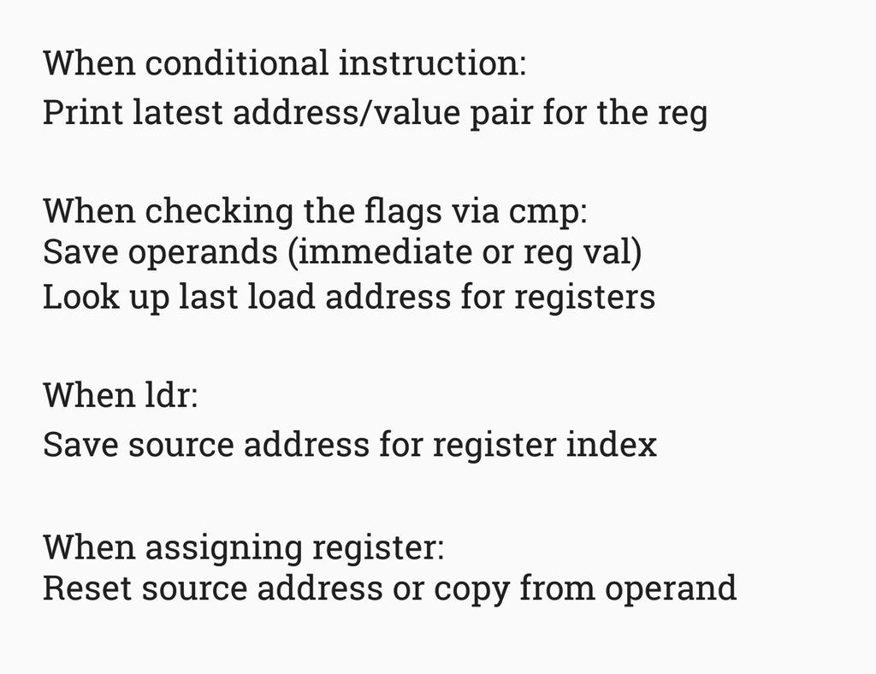
Attempt 1
Tried to add enough support to run the bootloader
Had lots of funny ideas
Taint tracking to simplify reverse-engineering MMIO?
Similar project(s): Check out AFL++ with QEMU mode and CMPCOV for fuzzing
Ultimately gave up because I got bored of single-stepping everything in GDB

Slide 6
One year later
S10 with Exynos9820 comes out
first non-iPhone ARM phone with high single-thread performance
I initially got one to do performance tests
I decided to definitely find some bugs and score some CVEs
I mean, I've been telling this to myself when buying every device in the last couple years
Time to recover that money

Slide 7
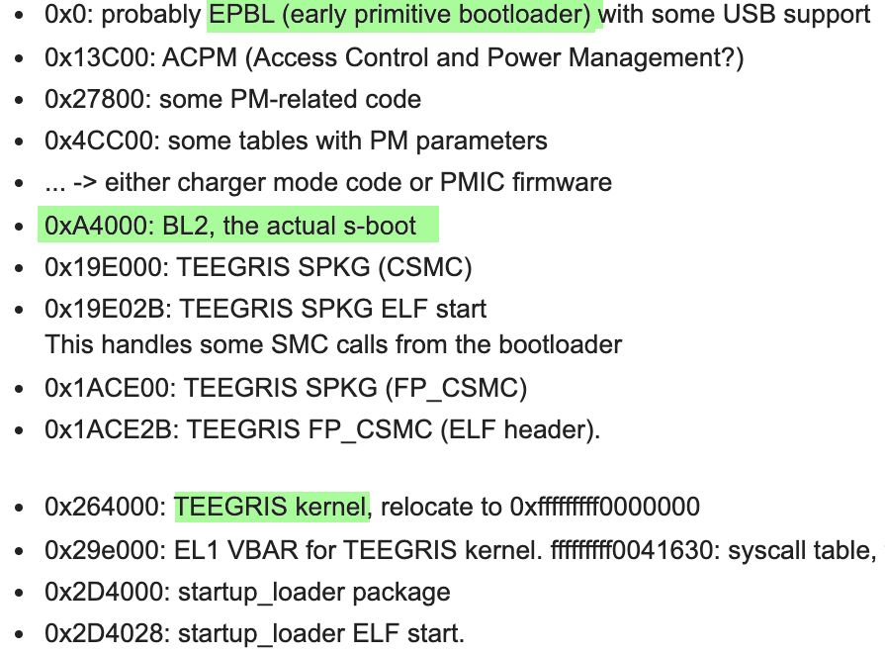
Reverse-engineering
Updates are TAR files with partition binaries
I focused primarily on the bootloader
Parts of bootloader are signed
We can identify them by entropy
Blocks of zeroes followed by garbage
Notes:
Updates are TAR files containing binaries which are flashed to individual partitions.
In principle, only two of them contain code - hypervisor ("uh.bin") and bootloaders ("sboot.bin").
Now, how do we load this code into the disassembler?
For hypervisor it's easy, even way too easy - we can get a normal ELF by removing the magic header.
For S-Boot, I did what I always do - had a look at the file in a Hex editor.
One can immediately notice some patterns, like a bunch of zeroes followed by a high-entropy area,
some strings.
So let's assume a high-entropy block of around 0x800 bytes after strings or zeroes is a signature.
With this, we get several binaries and we can try guessing their function from the strings.
Some of them have a very minimal amount of strings, though.
Nevertheless, aimed with this information and the knowledge of previous-generation
Exynos boot chain (it was public for Exynos4/Exynos5 from 2012 and has not changed *that* much),
we can figure out that the first chunk is the "EPBL" and the biggest one is the actual
feature-rich bootloader (BL2).
We can load it to Ghidra. For a start, let's assume any load address.
Knowing that RAM starts at 0x80000000 on Exynos, we can use something like that.
Once we let the auto-analysis complete, there are two areas to examine:
* binary start - here are where exception vectors typically are, and they sometimes
use hardcoded constants for the code/data addresses, as they're needed for relocation
or working before MMU is enabled.
* binary end, data section - while code is usually position-independent,
data is often not and will contain addresses which *should* point back into the binary.
Knowing that the binary is usually aligned by 1MB or 16MB (due to the MMU section size),
we really only need first two or three digits.
Anyway, the first revision of the bootloader seemed to be loaded at 0x8f000000,
while the subsequent one got changed to 0xc9000000.

Slide 8
Reverse-engineering
We can make an educated guess about the RAM addr from DTB
One can also use debug log menu (*#9900#) to get S-Boot log
The actual address does not matter much
Once disassembled, look around image start and end
Start is exception handler code, end is data
Both contain hardcoded pointers which allow to determine base addr

Slide 9
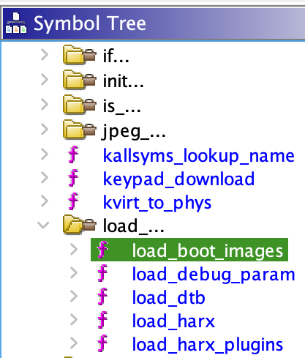
Reverse-engineering
Embedded binaries often contain debug strings
We can leverage this to identify function names
A script to rename functions from debug prints
https://gist.github.com/astarasikov/1a67b948f3ca61f348b8e3eccf963a42

Slide 10
Reverse-engineering
Looked around aimlessly and found something that looks like “memcpy"
You know it when you spend too much time with ARM assembly
Hmm, let's examine the callers. A lot of them. Luckily, some look weird.
Perhaps it’s not the best way to find bugs
Figured out Samsung deployed a new TEE OS - TEEGRIS
New code, must be buggy

Slide 11
building emulators with QEMU: Bootloader
Need to emulate basic peripherals: RAM controller, timer, UFS
16 registers needed to be emulated in total
Enough to have UART output and fallback into recovery/crash mode
Need to implement basic TEE calls in QEMU
Can leverage PSCI code for that
At this point, we can use QEMU to develop our exploits
Can inject code with GDB and single-step afterwards

Slide 12
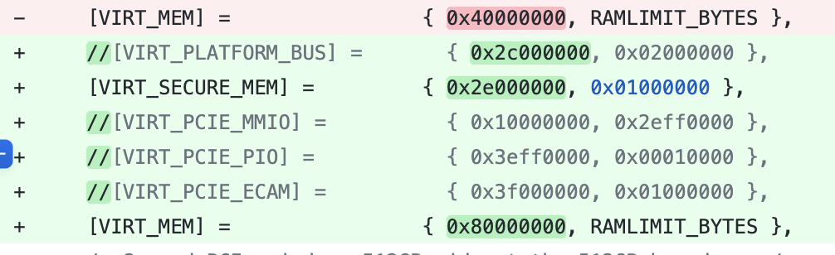
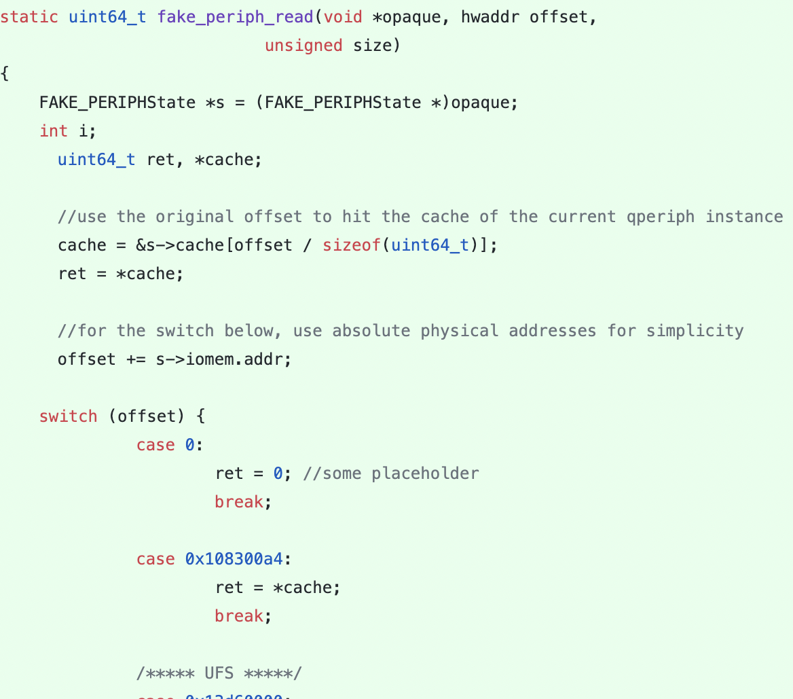
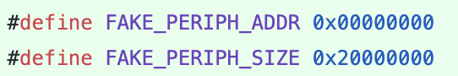
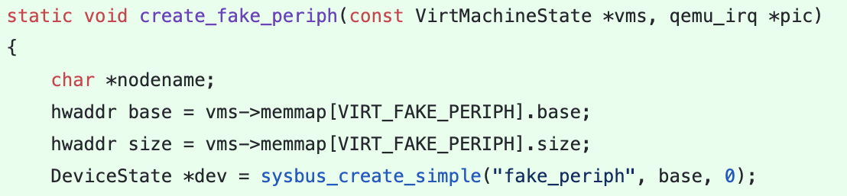
building emulators with QEMU: Bootloader
1. Move RAM region to match Exynos HW
4. Implement register emulation until it boots
2. Add peripheral region @addr 0
3. Register peripheral emulation device

Slide 13
building emulators with QEMU: TrustZone
QEMU has “Linux-user” target to run Linux binaries for another arch
Somewhat easy to leverage for fuzzing TEEs
Need to modify the ELF loader to setup correct AUX vectors (ELF parameters, like argc/argv for main, but earlier)
Need to implement TEEGRIS syscalls
I knew half of them from disassembly of the kernel.
Libtzsl.so just exports C wrappers for all syscalls too, much easier.
with AFL++ and QEMU mode, we can get coverage-guided fuzzing
All fine and good, but have found much better bugs with code review

Slide 14
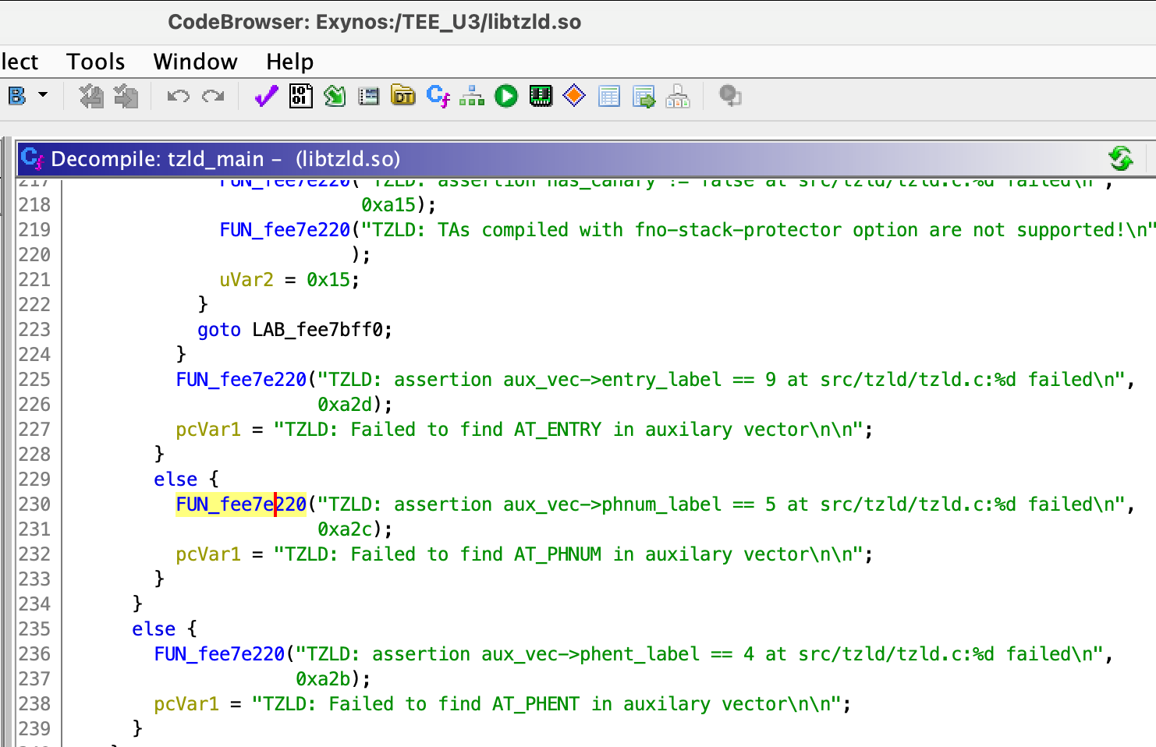
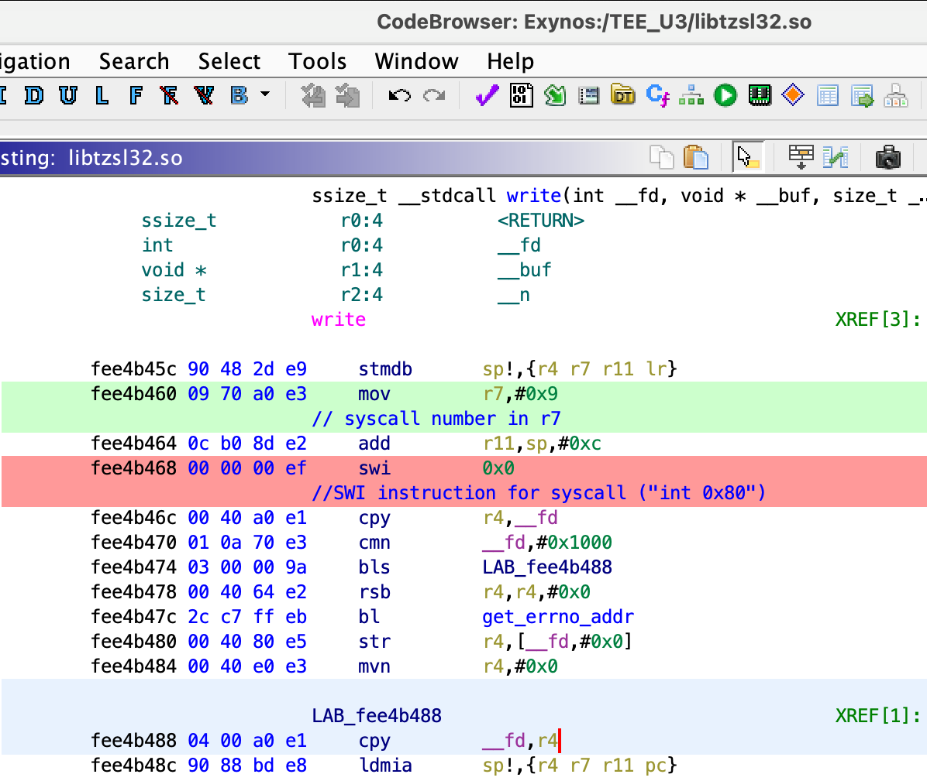
building emulators with QEMU: TrustZone
reverse-engineering ELF AUX vals - just look at the “entry” function
Syscalls: not difficult either

Slide 15
S-Boot bug #1
Stumbled upon the USB download protocol, also known as ODIN
Normally, PC sends “ODIN”, phone replies “LOKE” for download mode
There’s also upload mode
Previous research in this area http://hexdetective.blogspot.com/2017/02/exploiting-android-s-boot-getting.html
From time to time, new commands are added there
In S10, compared to S9, there’s a new command “SECCMD”

Slide 16
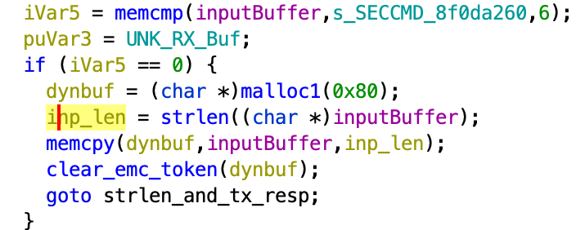
S-Boot bug #1
Something looks off here
I had no experience exploiting heap corruptions
Wrote a POC to fill memory with “AAAAAA” but it did not crash
Samsung initially rated as DoS

Slide 17
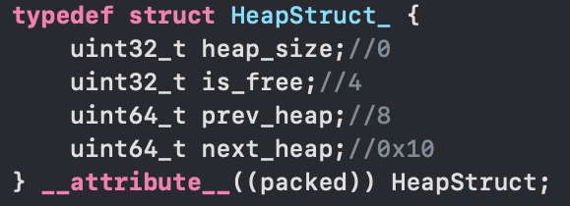
S-Boot bug #1
I knew that any heap corruption is a potential RCE
I set off to exploit this one
S-Boot heap allocator uses inline metadata and linked lists
Good candidate for exploitation
Heap header followed by payload
Upon alloc, splits heap in two
OOB write corrupts next heap hdr

Slide 18
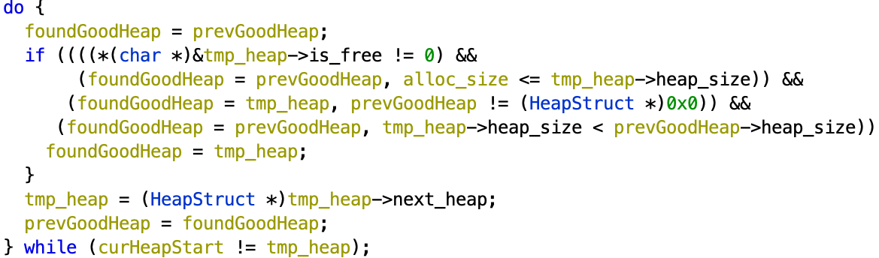
S-Boot bug #1
Allocation algorithm: iterate all chunks and find the smallest that fits
If it’s still too big, split it into two

Slide 19
S-Boot bug #1
Heap header is followed by data
Data is followed by the next heap header
We can link a new heap by writing OOB data
Sometimes, we get a crash in free/malloc afterward
Remember, allocator always chooses the largest heap
We can mark the chunk as free but with a huge size

Slide 20
S-Boot bug #1
So we can link our own chunk into the heap
But where do we put our payload?
Hard to use USB stack - almost always got a crash if corrupting more than 16 bytes
Remember the unsigned splash screen partition?
Can we put it into the splash JPEG?

Slide 21
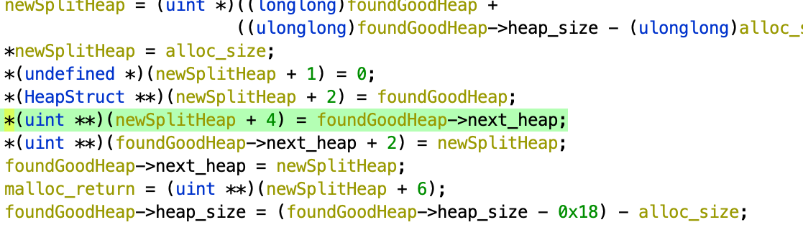
S-Boot bug #1
Not so fast
Upon allocation, we get a controlled write when heap is split
Unfortunately, heap_size is 32 bit & splash memory is past S-Boot range

Slide 22
S-Boot bug #1
Fortunately, there’s an address before s-boot memory which we can use
Download buffer for ODIN is at a low address in memory
Unfortunately, once you enter ODIN mode there’s no way to go to command mode and execute “SECCMD”
Fortunately, DDR retains its contents for a while
Let’s put data via the ODIN mode and reset the phone while holding the bootloader key combination

Slide 23
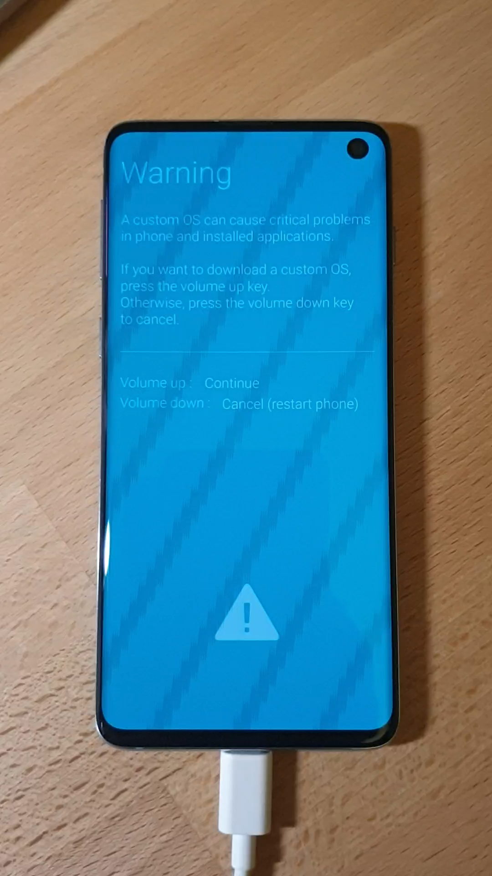
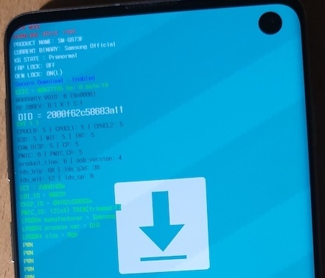
S-Boot bug #1

Slide 24
S-Boot bug #1
How to defeat W^X and ASLR?
There’s no ASLR
But did you have to use ROP?
ODIN download buffer is RWX…

Slide 25
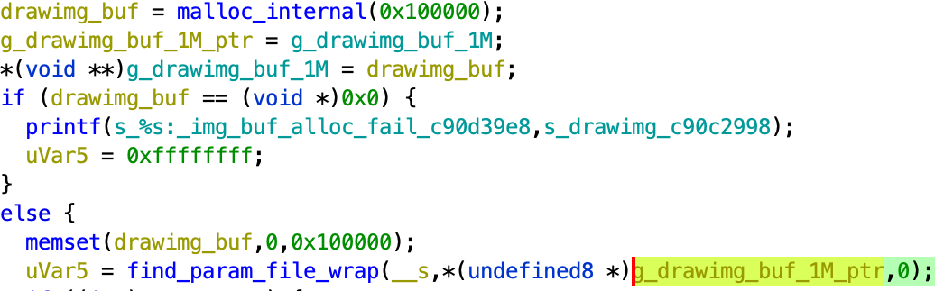
S-Boot bug #2
Remember, splash partition (“up_param”) is not signed
Splash screen is a JPEG among many in the TAR file
I spent days trying to find a bug in libJPEG or its glue code
Eventually, found something funny.

Slide 26
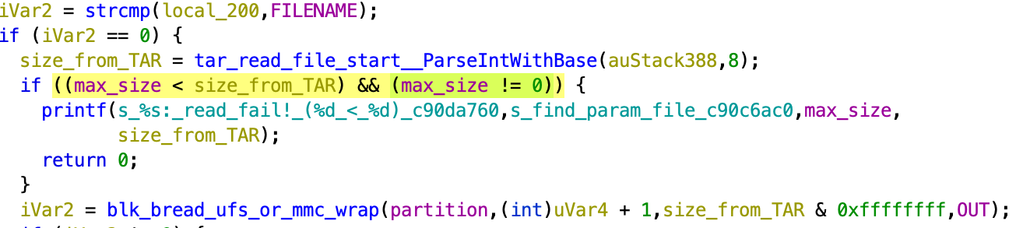
S-Boot bug #2
Typically, one needs both pointer and size to check for OOB safely
Here, the caller passes pointer and zero instead of size

Slide 27
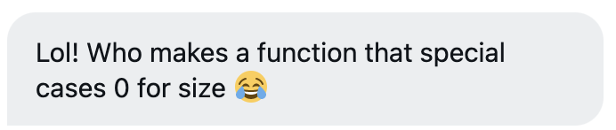
S-Boot bug #2
Reactions from fellow researchers who diffed the patch Exploitation should have been similar in principle.
Unfortunately, s-boot crashed upon using the old attack
Perhaps, heap allocation pattern is very different

Slide 28
S-Boot bug #2
What does s-boot even do upon a crash?
Turns out, it re-initializes heap but leaves all DATA/BSS intact
So I just corrupted a function pointer in DATA
Upon a crash, during re-init, our function gets executed

Slide 29
S-Boot bug #2
Bonus: remember using ODIN buffer and a hot reboot to put heap data?
I found another location
Examined all calls to “blk_read”
Turns out, “keystorage” partition is half a megabyte in size, it’s read to RAM but AVB only validates a few kilobytes
We can overwrite unused data after AVB footer with our payload
And that’s how you get persistent code-exec in bootloader

Slide 30
RKP hypervisor
RKP is a hypervisor from Samsung
Also known as UH - micro hypervisor
Its main job is to enforce RO/RX memory mapping for Linux
Also implements helpers for ROP mitigation
Previously researched extensively by Google Project Zero

Slide 31
RKP hypervisor
The binary is ELF, but obfuscated - no debug strings
No problem, let’s find the exception handler and research from there
Eventually mapped HVC call handlers
They all follow a pattern of using a function to validate EL1 addresses
You don’t want hypervisor to corrupt its own memory. I wouldn’t want it.

Slide 32
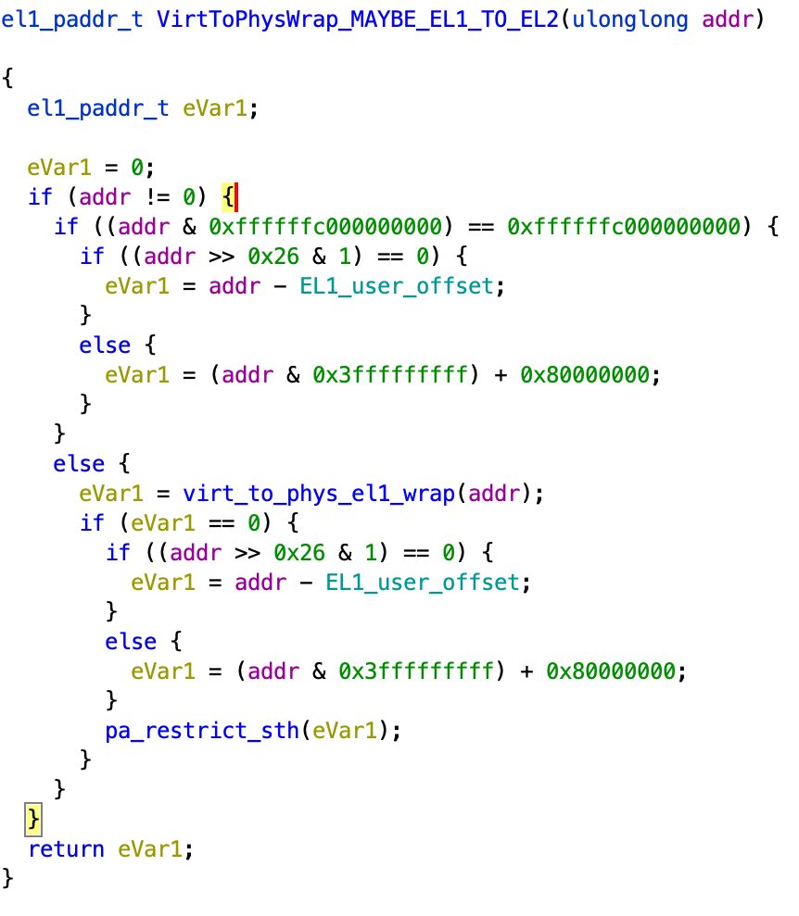
RKP hypervisor
If addr looks like Linux VA address, just add some offset
Otherwise, use MMU (“AT” insn) to translate
The latter case also checks the addr against the restricted list

Slide 33
RKP hypervisor
At first, I thought I got scooped because Samsung posted a fix with a similar description
Turns out, the “fix” was checking the address for NULL
Some RKP calls effectively perform “write-where” after validating (or not validating) EL1 addresses
Bonus bug: some validated base address but not the (untrusted) offset added to the base

Slide 34
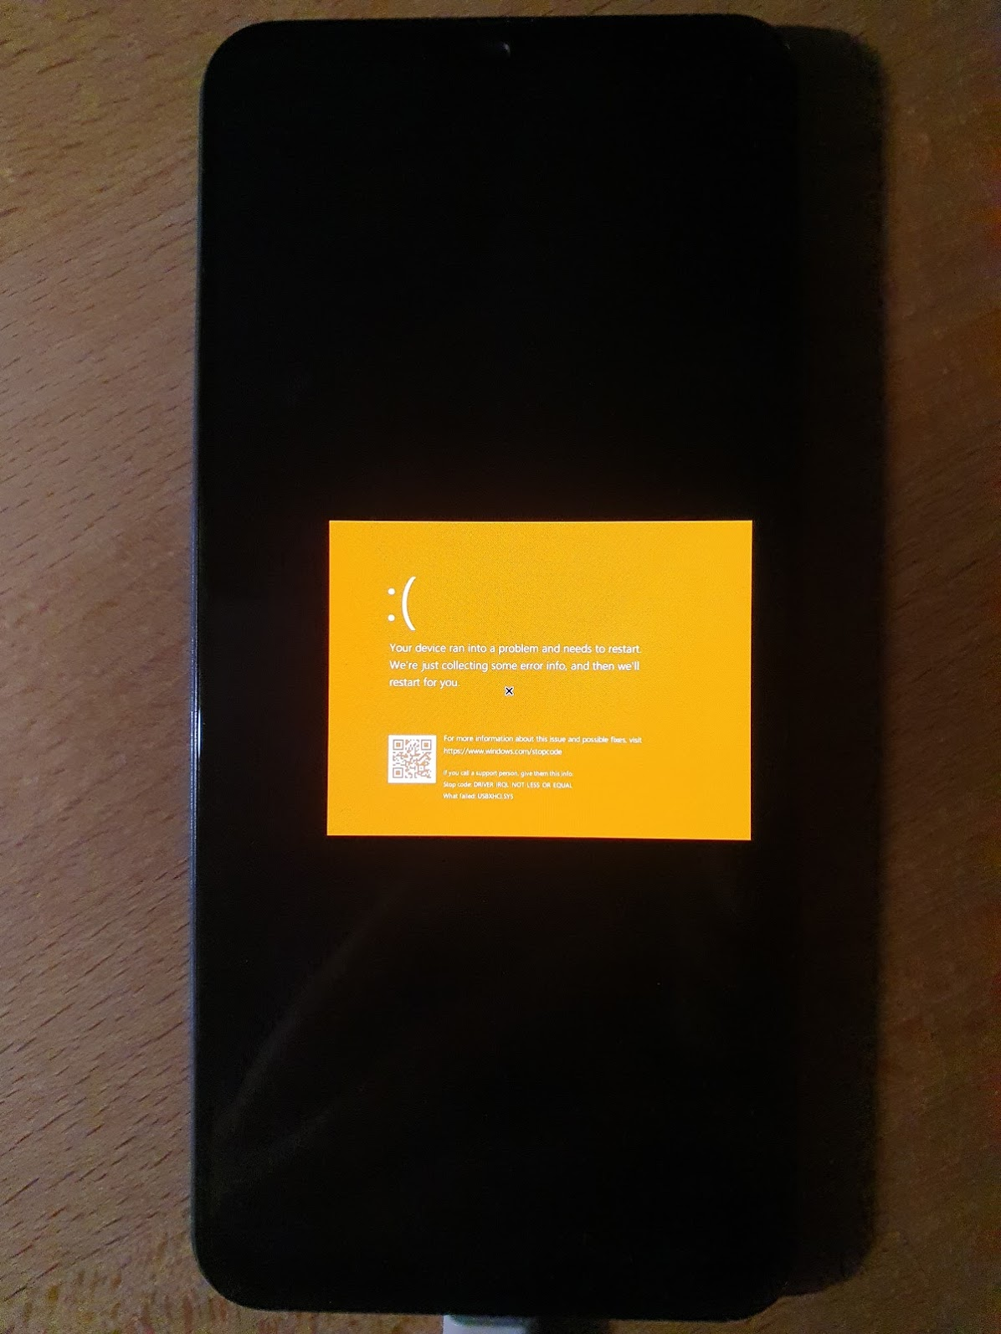
RKP hypervisor
I anyway started this project with one real goal
I am disappointed EL2 is not available to end-users because OEMs used it for DRM purposes
So…?
We have an exploit to go EL1->EL2
Tried to boot Linux in EL2
Mostly works, on 7 cores out of 8
Got KVM running Windows 10 with native speed

Slide 35
HArx
Well anyway I accidentally updated my phone
My precious RKP bugs were gone
I was furious, but I also just got the latest S20 phone
Motivation to continue research

Slide 36
HArx
HArx is the new hypervisor on Galaxy S20 series
It loads other hypervisors as plugins
Probably in anticipation of Hyper-V
Besides that, it sets up SMMU
Largely went unnoticed by the RE community so far…
A topic for another talk maybe?

Slide 37
A bit about TEE
TEEGRIS kernel looks solid when it comes to validating input
TEE apps core is also solid - parsers for certificates, TLVs
However, there are dozens of bugs in entrypoints
My impression is that TAs had already been researched/fuzzed
But got ported in a rush without understanding the trust boundary

Slide 38
TEEGRIS trusted apps
Not checking input/output buffer length
Rather unlikely to corrupt TA memory, just other EL1 buffers
Leftover debug code with string parsing
Classic buffer overflows. At least there are stack canaries in most TAs
Camera and biometrics TAs need to access physical memory
Initially there were no allow-lists per TA
EL1 could ask TA to “mmap” TA’s memory range

Slide 39
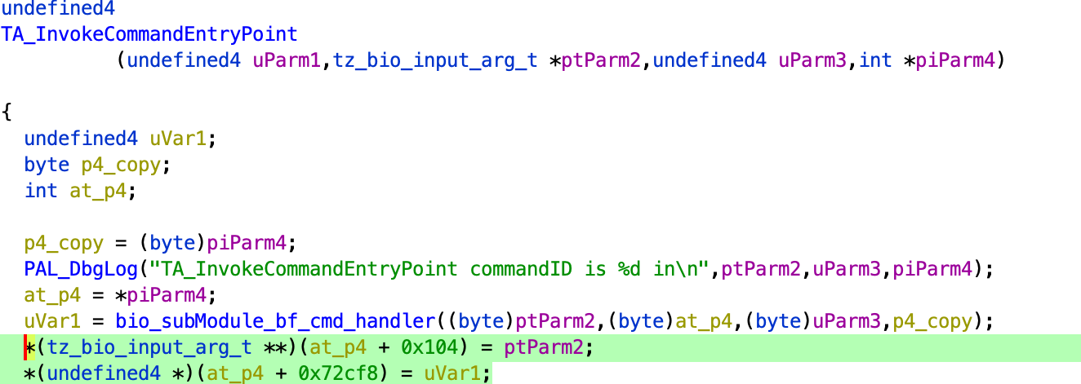
TEEGRIS trusted apps
Entrypoint: processing untrusted arguments from Linux.
OOB write past the arguments buffer.
Notes:
Not the most useful exploitation primitive, though.

Slide 40
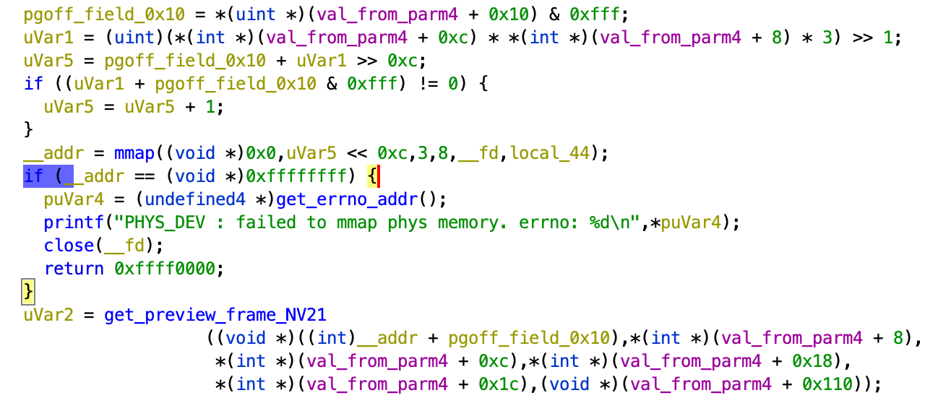
TEEGRIS trusted apps
MMAP arbitrary address with TrustZone privileges

Slide 41
Related Research
TeamT5 S-Boot bug (duplicate with mine) https://teamt5.org/en/posts/blackhat-s-talk-breaking-samsung-s-root-of-trust-exploiting-samsung-secure-boot/
https://census-labs.com/news/2020/07/22/emulating-hypervisors-a-samsung-rkp-case-study-offensivecon-2020/
https://blog.longterm.io/samsung_rkp.html

Slide 42
Conclusions for defenders.
What could have prevented these bugs?
SECCMD memcpy in S-Boot
Static analysis: possibly, but not guaranteed
Need to manually annotate taint sources
Fuzzing: possibly, but quite costly
Need to port S-Boot to run on Linux desktop
Need a good dictionary of inputs
Using memory safe language: yes
Notes:
The trick with static analysis is that sometimes it's necessary
to manually annotate functions (such as USB RX) as taint sources.
Quite hard to find with fuzzing. For example, even after I found the
bug it was hard to confirm it's exploitable because it only crashes on
the third attempt. Additionally, it requires that someone adds all
strings to the fuzzer dictionary.
Could have been found with fuzzing if S-Boot got recompiled for desktop
Linux with some functions replaced by stubs and ASAN enabled.
But that's a lot of work, comparable to the effort of bringing
up a new platform. That costs time and money.
Definitely could have been avoided with a memory safe language like Rust.

Slide 43
Conclusions for defenders.
What could have prevented these bugs?
“drawimg” heap OOB write in S-Boot
Static analysis: same. Possibly, but not guaranteed
Fuzzing: same. Possibly, but quite costly
Code review: maybe. However, it got exploitable due to refactoring
Using memory safe language: not sure
JPEG parser is a C library
Easy to introduce a bug at the FFI boundary between safe and unsafe
Notes:
Code review: that's an interesting question. The OOB read bug has
been there forever but it was not exploitable because the target buffer
was located after S-Boot code and data. Someone obviously thought
of such an attack scenario. The bug got exploitable when the code
got refactored recently.
Fuzzing: again, it's hard to fuzz on real hardware.
Memory safe language: it's not like you're going to write a
JPEG decoder from scratch so it's quite easy to make the same mistake
when interfacing Rust with a C version of libjpeg.
Anyway, it's a design issue really (read: the partition should
have been signed in the first place).

Slide 44
Conclusions for defenders.
What could have prevented these bugs?
RKP/UH issues
Static analysis: unlikely
Fuzzing: not with a random one, needs some domain knowledge
Existing research has not identified this particular bug
Memory safe language: probably not
The bug is related to MMU and a different address space
Most languages don’t model system with such precision
Enabling ASLR and stack cookies wouldn’t hurt though
Notes:
could not have been found with static analysis.
Unlikely with random fuzzing: a good understanding of requirements is necessary
to design the corpus which would contain magic addresses (0xffffffffc0000000).
Code review: mention existing SVEs by other researchers from 2017 and 2019,
mention that this function was modified twice
(once to introduce the NULL check and second time to
remove the 0x80000000 offset from calculation). So it shows that the
bug is extremely easy to overlook and quite hard to find.
This is a bug at the lowest level of abstraction: MMU interaction.
A high-level language like Rust or a static analyzers
wouldn't help as they don't model such details.
So there's no one to blame here.
Although some mitigations like ASLR and EL2 stack address randomization
could make exploitation very unreliable.

Slide 45
Conclusions for defenders
Android userland and Linux got more secure with the use SELinux
Focus is shifting to firmware and boot chain
Firmware world is lacking in both mitigations and development tools
Static and dynamic analysis tools help a bit, but require dev support
Bugs tend to be in fresh code or the one which is 3 years and older
Researchers focus on the overall system, not one area of responsibility
I believe in re-reviewing stuff randomly from time to time
These last two points are harder to formalise in a corporate env

Slide 46
Recap. Where do security issues happen?
In newly-developed code that has not been reviewed by attackers
Where someone has already looked but that was 3 years ago
Where analysis tools/languages don't model the system at the required detail level (MMU, hardware component interaction)

Slide 47
Research tips
You need to dump Firmware from the device
Firmware is encrypted
Of all phone/SoC vendors, only two encrypt most of FW
You need an existing bug to dump it
Most of it is not encrypted and can be downloaded online
You need a fancy bug and a working exploit to participate in bug bounty
A bug is needed, but don’t be shy if it’s not too fancy

Slide 48
Bug bounty tips
Submit early to allow the company to root cause and fix the bug ASAP
Submit follow-up info for a better reward
A good PoC increases payout a few times
at least with some vendors

